Slide 1
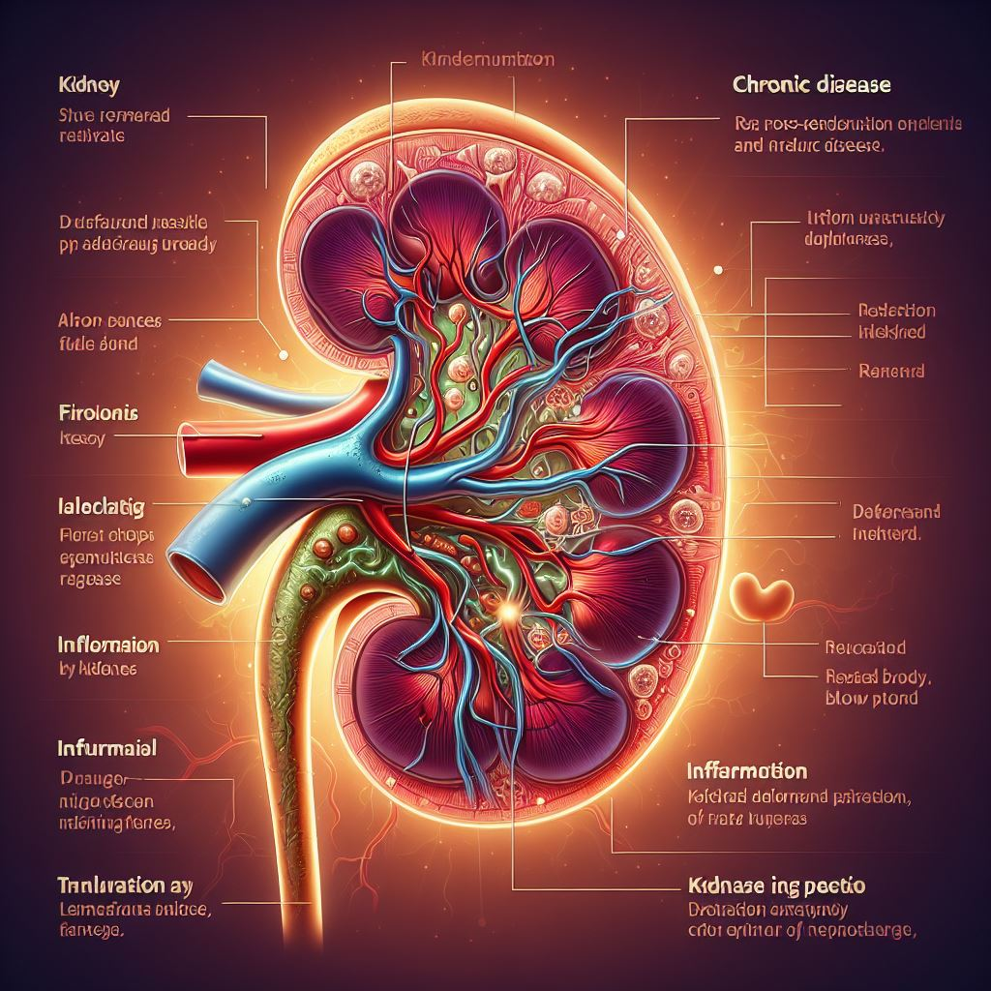
Healthcare
Chronic Kidney Disease data analysis and prediction

Slide 2
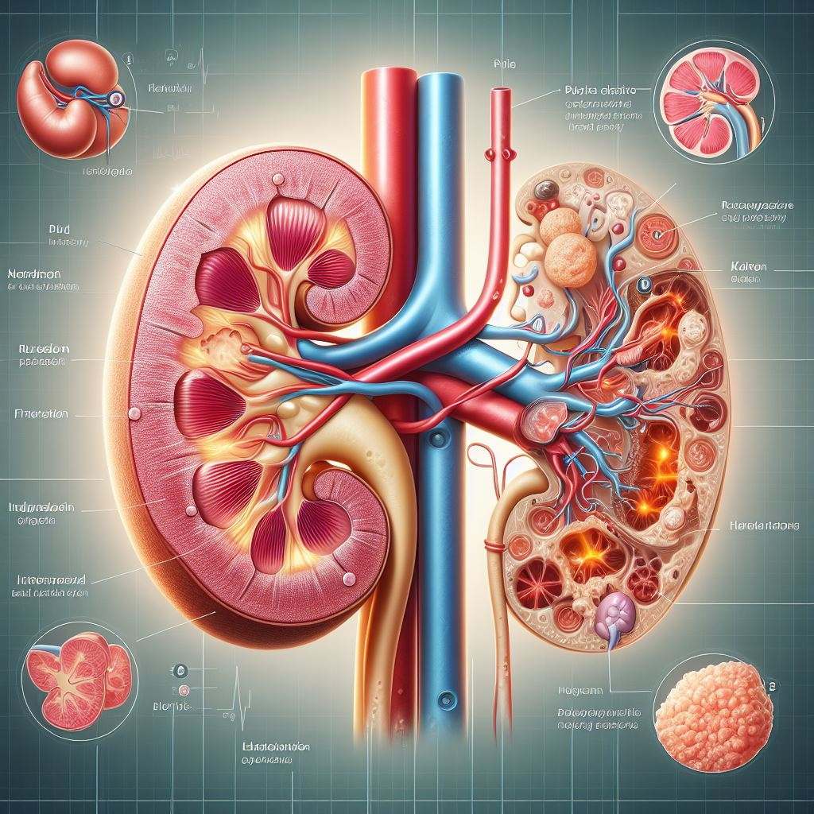
CKD
What is Chronic Kidney Disease?
Chronic kidney disease includes conditions that damage our kidneys and decrease their ability to keep us healthy by filtering wastes from our blood. If kidney disease worsens, wastes can build to high levels in your blood and make you feel sick. We may develop complications like:
High Blood Pressure
Anaemia (Low Blood Count)
Weak Bones
Poor Nutritional Health
Nerve Damage
Machine learning

Slide 3
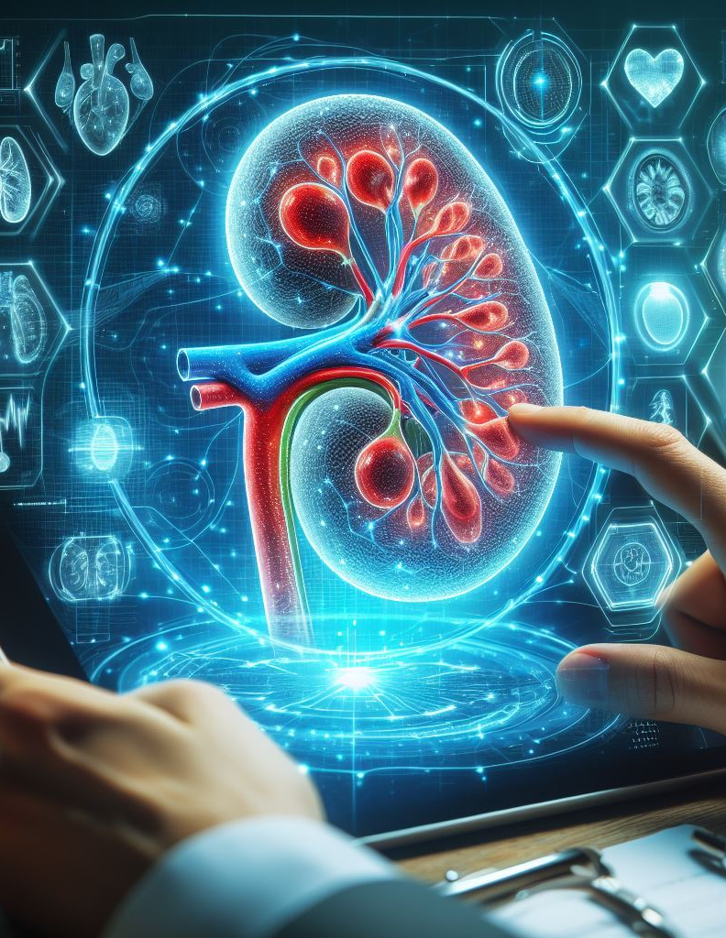
Introduction
The project aims to develop an accurate and fast prediction model for chronic kidney disease (CKD) using machine learning techniques. The model will focus on reducing the number of attributes required for prediction while maintaining high accuracy. The goal is to aid in early detection and management of CKD, potentially improving patient outcomes and reducing the burden on healthcare systems

Slide 4
1. Understanding Chronic Kidney Disease (CKD):
Research the medical literature to understand the basics of chronic kidney disease, including its definition, causes, symptoms, risk factors, diagnosis, and treatment options.
Familiarize yourself with the medical terminology and concepts related to CKD.

Slide 5
1. Understanding Chronic Kidney Disease (CKD):
Research the medical literature to understand the basics of chronic kidney disease, including its definition, causes, symptoms, risk factors, diagnosis, and treatment options.
Familiarize yourself with the medical terminology and concepts related to CKD.

Slide 6
2. Identify Datasets:
Look for publicly available datasets related to chronic kidney disease. Some sources where you might find datasets include:
Kaggle: Kaggle is a platform where data scientists and machine learning enthusiasts share datasets and compete in data science competitions. You might find CKD-related datasets here.
Healthcare institutions or research organizations: Sometimes, healthcare institutions or research organizations release anonymized datasets for research purposes. You can search for such datasets on their websites or contact them directly.
Government health agencies: Government health agencies may provide access to health-related datasets through their websites or data portals.

Slide 7
3. Data Exploration:
Once you've identified potential datasets, explore them to understand their structure, features, and quality.
Check the data documentation or metadata to understand the meaning of each feature and how the data was collected.
Look for any missing values, outliers, or inconsistencies in the data.

Slide 8
4. Data Acquisition and Preprocessing:
Download or obtain the selected dataset(s) from the source(s) you identified.
Preprocess the data to ensure it's clean and suitable for machine learning tasks. This may involve tasks such as:
Handling missing values: Decide on an appropriate strategy for dealing with missing values (e.g., imputation, deletion).
Data cleaning: Remove duplicates, correct errors, and address any inconsistencies in the data.
Feature selection: If the dataset contains a large number of features, consider selecting a subset of features that are likely to be most relevant for predicting CKD.
Data transformation: Perform any necessary transformations such as encoding categorical variables, scaling numerical features, or normalizing the data.

Slide 9
4. Data Acquisition and Preprocessing:
Download or obtain the selected dataset(s) from the source(s) you identified.
Preprocess the data to ensure it's clean and suitable for machine learning tasks. This may involve tasks such as:
Handling missing values: Decide on an appropriate strategy for dealing with missing values (e.g., imputation, deletion).
Data cleaning: Remove duplicates, correct errors, and address any inconsistencies in the data.
Feature selection: If the dataset contains a large number of features, consider selecting a subset of features that are likely to be most relevant for predicting CKD.
Data transformation: Perform any necessary transformations such as encoding categorical variables, scaling numerical features, or normalizing the data.

Slide 10
5. Training and Building the Model:
Once have the data suitable for the model, we split the data into a training data and a test data so that we can build the model.
Splitting the data is the crucial part for training the model. It help the model to separate the data set into two parts for training and for testing.
Then after splitting the data we can start training the model and continue building it so that we can use the model to predict the chronic disease.

Slide 11
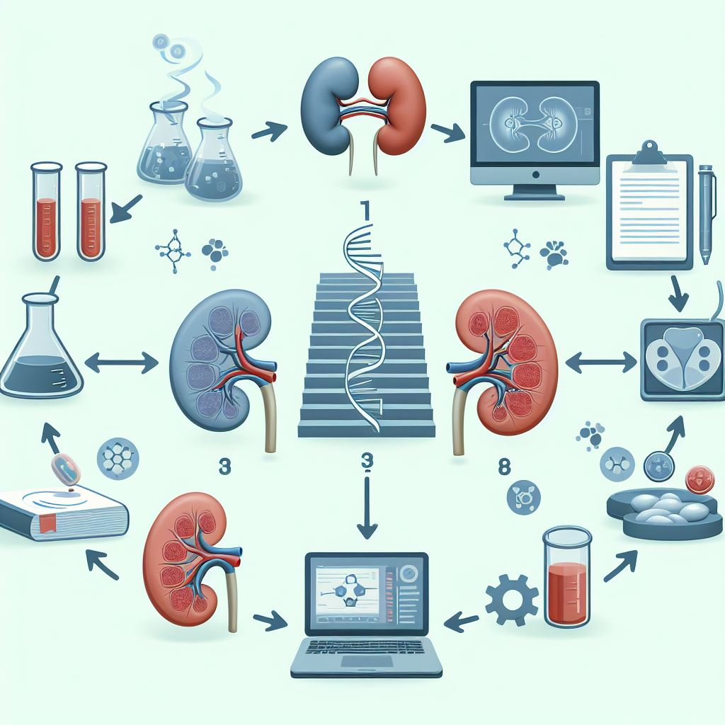
Chronic Kidney Disease Prediction
conclusion
In conclusion, the project aims to use machine learning to accurately detect chronic kidney disease by analyzing patient data. By developing a reliable and accurate predictive model, the project has the potential to contribute significantly to the early identification and intervention of the disease, improving patient outcomes

Slide 12
Thank You
Artificial Intelligence Company Presentation Template

